Slide 1
EE227 – Digital Logic Design
Lecture 14

Slide 2
Outline
Binary Adder
4 Bit Binary Adder
Carry Propagation
Carry Lookahead Generator
Binary Subtractor
Overflow
4 – Bit Binary Adder – Subtractor with Overflow Detection

Slide 3
Binary Adder
2 bits can be added with a half adder
3 bits can be added with a full adder
We can construct a full adder with 2 half adders
A binary adder is a digital circuit that produces the arithmetic sum of two binary numbers
It can be constructed with full adders connected in cascade, with the output carry from each full adder connected to the input carry of the next full adder in the chain
Generally if we want to add n bits we will need
n full adders
OR
1 half adder and (n – 1) full adders

Slide 4
4 – Bit Binary Adder
A typical approach of design will require 9 inputs and truth table will contain 2⁹ = 512 entries
But with the help of an iterative cascading method the design can be simplified
A 4 bit binary adder can be constructed by cascading 4 full adders
The input carry of first full adder is fixed to 0
The bits are added with full adders, starting from the least significant position
The output carry of a stage is connected to the input carry of next stage
As the carry is propagating from one stage to another, it is also called a Ripple Carry Adder

Slide 5
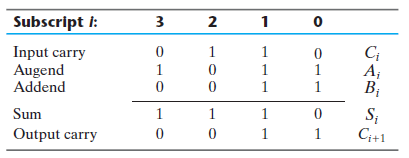
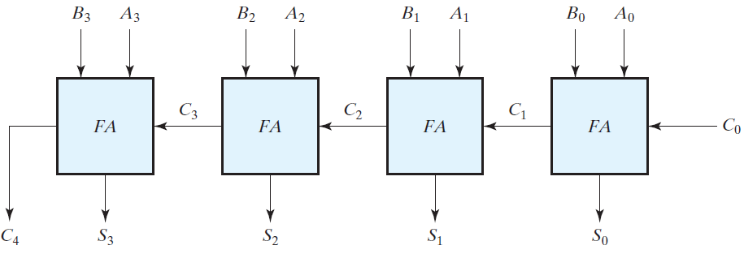
4 – Bit Binary Ripple Carry Adder
A = 1011 and B = 0011
Their sum S = 1110 is formed with the four-bit adder as follows

Slide 6
Carry Propagation (1/3)
The binary numbers are available to adders in parallel but carries are not
The carry is propagating in ripple carry adder from one stage to other
It will cause a delay in the computation of sum bits
The longest propagation delay time in an adder is the time it takes the carry to propagate through the full adders
The carry propagation time is found in terms of gate levels

Slide 7
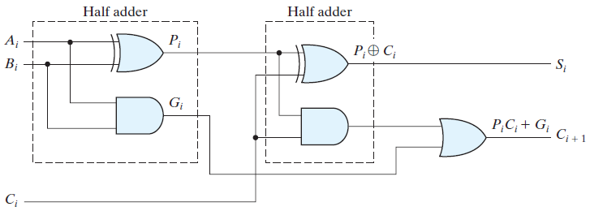
Carry Propagation (2/3)
The number of gate levels for the carry propagation can be found from the circuit of the full adder
The signal from the input carry C_{i} to the output carry C_{i+1} propagates through an AND gate and an OR gate, which constitute two gate levels
If there are four full adders in the adder, the output carry C₄ would have 2 x 4 = 8 gate levels from C₀ to C₄
For an n -bit adder, there are 2n gate levels for the carry to propagate from input to output

Slide 8
Carry Propagation (3/3)
The carry propagation time is an important attribute of the adder because it limits the speed with which two numbers are added
Since all other arithmetic operations are implemented by successive additions, the time consumed during the addition process is critical
An obvious solution for reducing the carry propagation delay time is to employ faster gates with reduced delays
However, physical circuits have a limit to their capability
Another solution is to increase the complexity of the equipment in such a way that the carry delay time is reduced
The most widely used technique employs the principle of carry lookahead logic

Slide 9
Carry Lookahead Generator (1/4)
From the circuit
P_{i} = A_{i} ⊕ B_{i} G_{i} = A_{i}B_{i}
The output sum and carry are
S_{i} = P_{i} ⊕ C_{i} C_{i+1} = G_{i} + P_{i}C_{i}
G_{i} is called a carry generate , and it produces a carry of 1 when both A_{i} and B_{i} are 1 regardless of the input carry C_{i}
P_{i} is called a carry propagate

Slide 10
Carry Lookahead Generator (2/4)
C_{i+1} = G_{i} + P_{i}C_{i}
We can write the expressions of output carries
C₀ = input carry
C₁ = G₀ + P₀C₀
C₂ = G₁ + P₁C₁
C₂ = G₁ + P1(G₀ + P₀C₀)
C₂ = G₁ + P₁G₀ + P₁P₀C₀
C₃ = G₂ + P₂C₂
C₃ = G₂ + P₂G₁ + P₂P₁G₀ + P₂P₁P₀C₀
Now a two level implementation of output carries is possible which is shown in next slide

Slide 11
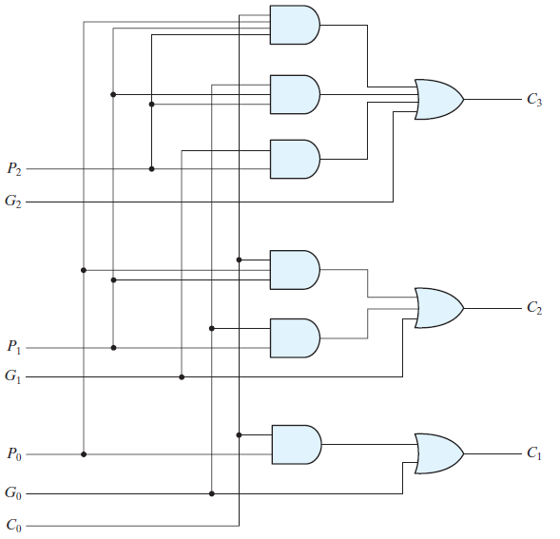
Carry Lookahead Generator (3/4)

Slide 12
Carry Lookahead Generator (4/4)
The circuit on previous slide can add in less time
Because C₃ does not have to wait for C₂ and C₁ to propagate
in fact, C₃ is propagated at the same time as C₁ and C₂
This gain in speed of operation is achieved at the expense of additional complexity (hardware)
All the carries are generated after a two level of gate delays

Slide 13
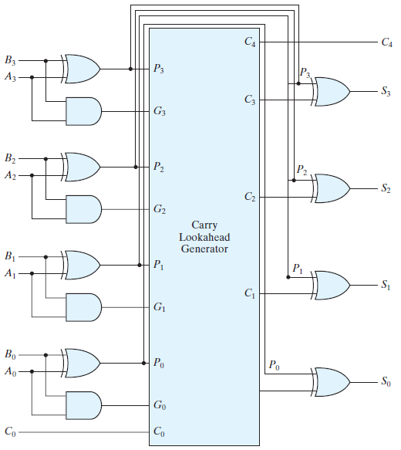
4 bit Adder with Carry Lookahead Generator

Slide 14
Binary Subtractor
The subtraction of unsigned binary numbers can be done most conveniently by means of complements
The subtraction A – B can be done by taking the 2’s complement of B and adding it to A
The 2’s complement can be obtained by taking the 1’s complement and adding 1 to the least significant pair of bits
The 1’s complement can be implemented with inverters or XOR gate and a 1 can be added to the sum through the input carry

Slide 15
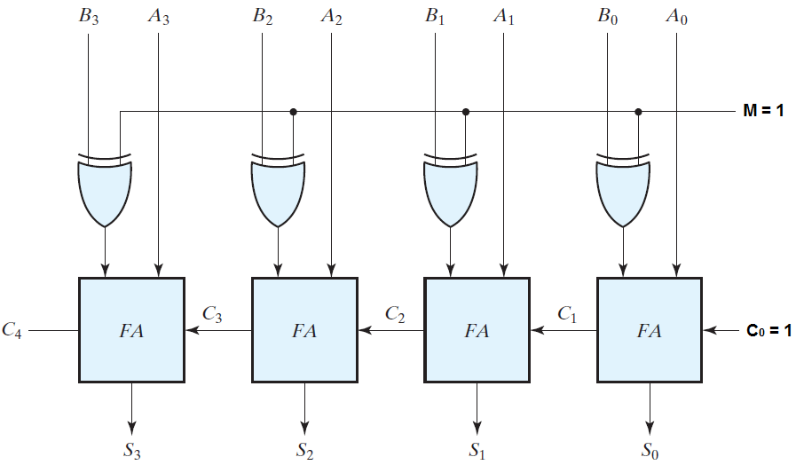
4 – Bit Binary Subtractor

Slide 16
Overflow
When two numbers with n digits each are added or subtracted and the result is a number occupying (n + 1) digits, we say that an overflow occurred
Detection of overflow is different for signed and unsigned numbers
For Unsigned Numbers
Overflow occurs
If there is an end carry out of most significant bit
For Signed Numbers
Overflow occurs
If two positive numbers are added and result is negative
If two negative numbers are added and result is positive

Slide 17
Overflow Examples
When two 8 bit unsigned numbers A = 144 and B = 112 are added:
The result will be 256, which cannot fit in an 8 bit register, so there will be an overflow
When two 8 bit signed numbers +70 and +80 are added:
The result is +150 which will not fit in an 8 bit register, so there will be an overflow
When two 8 bit signed numbers -70 and +80 are subtracted:
The result is -150 which will not fit in an 8 bit register, so there will be an overflow
An overflow condition in signed numbers can be detected by observing the carry into the sign bit position and the carry out of the sign bit position. If these two carries are not equal, an overflow has occurred

Slide 18
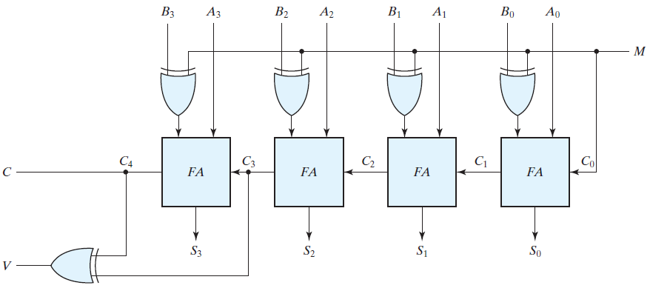
4 – Bit Binary Adder/Subtractor with Overflow Detection
If M is 1, the circuit will act as a subtractor
If M is 0, the circuit will act as an adder
C and V are used for detecting the overflow
For unsigned numbers if C = 1, it indicates an overflow
For signed numbers is V = 1, it indicates an overflow

